Slide 1
Cooling in a Cu-Ni Binary
T(°C)
L (liquid)
L: 35wt%Ni
• Binary isomorphous phase diagram
Cu-Ni
system
130
0
A
α
L
+
• Consider
C_{o} = 35 wt%Ni.
L: 35 wt% Ni
α: 46 wt% Ni
B
35
C
46
32
43
D
L: 32 wt% Ni
24
36
α
α
:
43 wt% Ni
120
0
L
+
E
L: 24 wt% Ni
α
α
:
36 wt% Ni
(solid)
110
0
20
3
0
35
4
0
5
0
C
o
wt% Ni

Slide 2
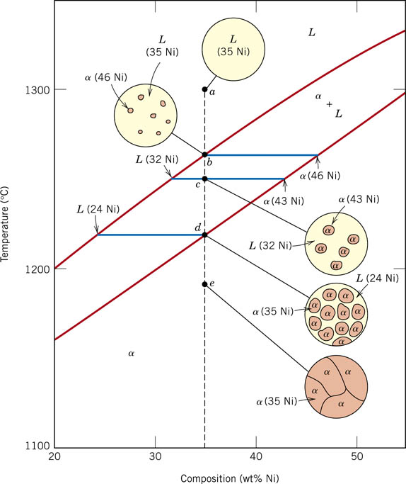
Very slow cooling during solidification

Slide 3
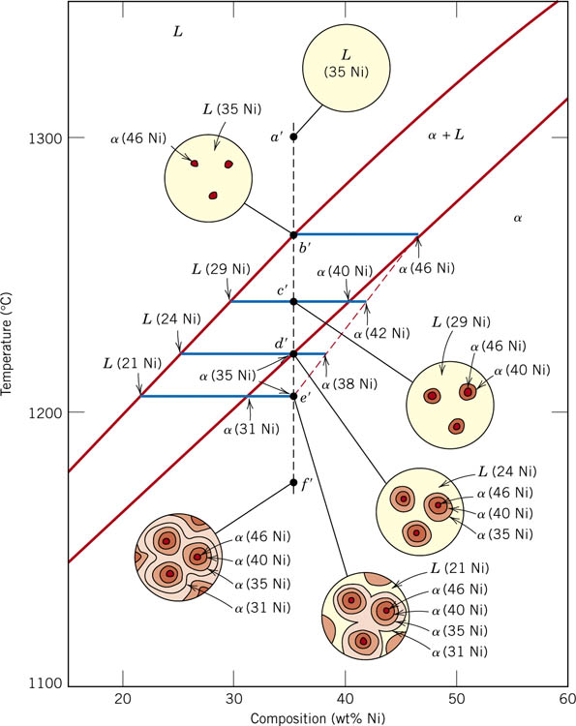
Non-equilibrium/ Fast Cooling
Notes:
f05_09_pg267.jpg

Slide 4
Cored vs Equilibrium Phases
• C_{α} changes as we solidify.
• Cu-Ni case:
First α to solidify has C_{α} = 46 wt% Ni.
Last α to solidify has C_{α} = 35 wt% Ni.
• Fast rate of cooling:
Cored structure
• Slow rate of cooling:
Equilibrium structure
α
Uniform C
α
:
First
to solidify:
46 wt% Ni
35 wt% Ni
Last
α
to solidify:
< 35 wt% Ni

Slide 5
Binary-Eutectic Systems
has a special composition
with a min. melting T.
2 components
Cu-Ag
system
T(°C)
Ex.: Cu-Ag system
1200
• 3 single phase regions
L (liquid)
(L,
α, β
)
1000
• Limited solubility:
α
L
+
α
800
779°C
L
+
β
β
α
: mostly Cu
T_{E}
8.0
71.9
91.2
β
: mostly Ag
600
• T_{E}
: No liquid below T_{E}
α
+
β
• C_{E}
: Min. melting T_{E}
400
composition
200
0
20
40
60
C_{E}
80
100
• Eutectic transition
L(C_{E}) α(C_{αE}) + β(C_{βE})
C_{o}
,
wt% Ag

Slide 6
EX: Pb-Sn Eutectic System (1)
• For a 40 wt% Sn-60 wt% Pb alloy at 150°C, find...
--the phases present:
α + β
Pb-Sn
system
T(°C)
--compositions of phases:
C_{O} = 40 wt% Sn
C_{α} = 11 wt% Sn
300
L (liquid)
C_{β} = 99 wt% Sn
--the relative amount
of each phase:
α
L
+
α
200
183°C
L
+
β
β
18.3
61.9
97.8
S
C_{β} - C_{O}
150
R
S
W
α
=
=
R+S
C_{β} - C_{α}
100
α
+
β
99 - 40
59
=
=
= 67 wt%
99 - 11
88
R
C_{O} - C_{α}
0
11
20
40
60
80
99
100
W
β
=
=
C_{α}
C_{o}
C, wt% Sn
C_{β}
R+S
C_{β} - C_{α}
40 - 11
29
=
=
= 33 wt%
99 - 11
88

Slide 7
EX: Pb-Sn Eutectic System (2)
• For a 40 wt% Sn-60 wt% Pb alloy at 200°C, find...
--the phases present:
α + L
Pb-Sn
system
T(°C)
--compositions of phases:
C_{O} = 40 wt% Sn
C_{α} = 17 wt% Sn
300
L (liquid)
C_{L} = 46 wt% Sn
L
+
α
--the relative amount
of each phase:
220
α
200
R
S
L
+
β
β
183°C
C_{L} - C_{O}
46 - 40
W
α
=
=
100
C_{L} - C_{α}
46 - 17
α
+
β
6
=
= 21 wt%
29
0
17
20
40
46
60
80
100
C_{O} - C_{α}
23
C_{α}
C_{o}
C_{L}
C, wt% Sn
W
L
=
=
= 79 wt%
C_{L} - C_{α}
29

Slide 8
Microstructures in Eutectic Systems: I
• C_{o} < 2 wt% Sn
• Result:
--at extreme ends
--polycrystal of α grains
i.e., only one solid phase.
T(°C)
L: C_{o} wt% Sn
400
L
α
300
L
L
+
α
α
200
(Pb-Sn
T_{E}
α: C_{o} wt% Sn
System)
100
α
+
β
0
10
20
30
C_{o}
C_{o}
,
wt% Sn
2
(room T solubility limit)

Slide 9
Microstructures in Eutectic Systems: II
• 2 wt% Sn < C_{o} < 18.3 wt% Sn
• Result:
  Initially liquid + α
  then α alone
  finally two phases
    α polycrystal
    fine β-phase inclusions
T(°C)
L: C_{o} wt% Sn
400
L
L
300
α
L
+
α
α: C_{o} wt% Sn
α
200
T_{E}
α
β
100
α
+
β
Pb-Sn
system
0
10
20
30
2
C_{o}
C_{o}
,
wt% Sn
(sol. limit at T
room
)
18.3
(sol. limit at T_{E})

Slide 10
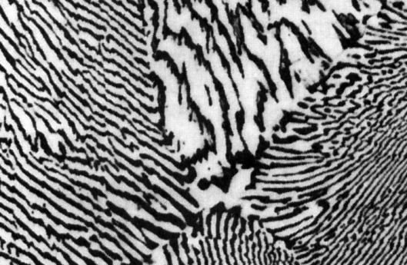
Microstructures in Eutectic Systems: III
• C_{o} = C_{E}
• Result: Eutectic microstructure (lamellar structure)
--alternating layers (lamellae) of α and β crystals.
T(°C)
Micrograph of Pb-Sn
eutectic
L: C_{o} wt% Sn
microstructure
300
L
Pb-Sn
system
L
+
α
α
β
200
183°C
L + β
T_{E}
100
α + β
160 μm
β: 97.8 wt% Sn
α: 18.3 wt%Sn
0
20
40
60
80
100
18.3
C_{E}
97.8
61.9
C, wt% Sn

Slide 11
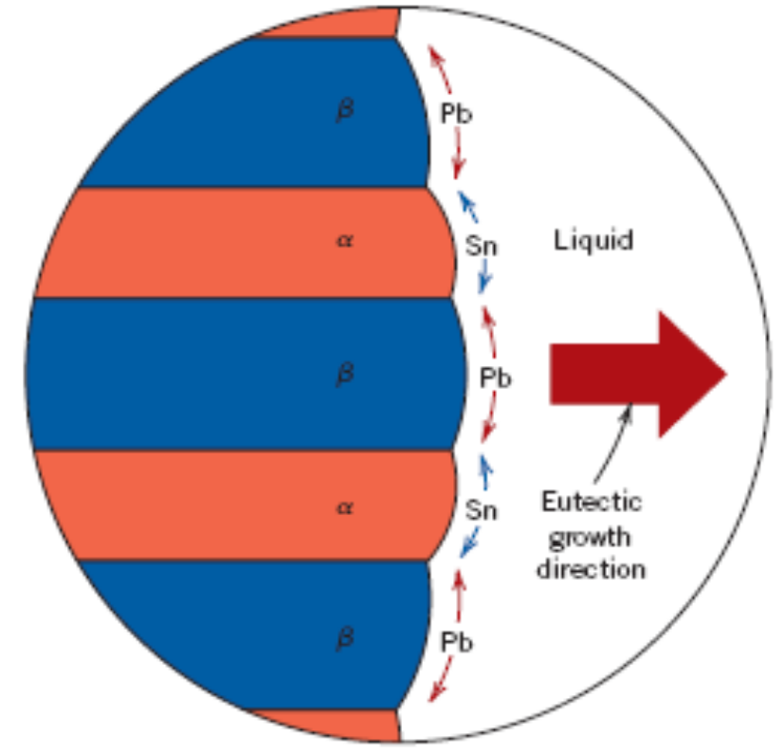
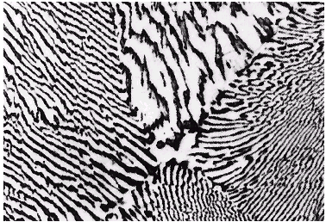
Lamellar Eutectic Structure

Slide 12

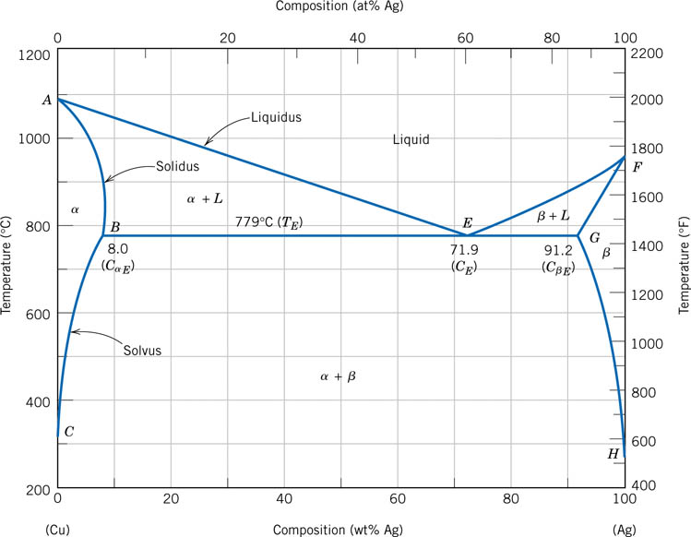

Eutectic Phase Diagram
Apply Gibbs Phase Rule
Notes:
f07_09_pg269.jpg

Slide 13
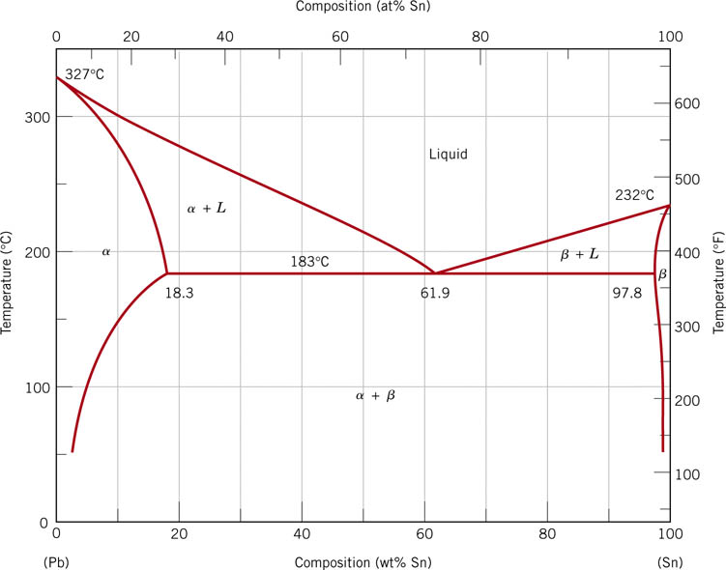
Pb-Sn System
Notes:
f08_09_pg271.jpg

Slide 14
Microstructures in Eutectic Systems: III
• If the Liquid composition is Euctectic composition
• Result: Eutectic microstructure (lamellar structure)
--alternating layers (lamellae) of α and β crystals.
T(°C)
Micrograph of Pb-Sn
eutectic
L: C_{o} wt% Sn
microstructure
300
L
Pb-Sn
system
L
+
α
α
β
200
183°C
L + β
T_{E}
100
α + β
160 μm
β: 97.8 wt% Sn
α: 18.3 wt%Sn
0
20
40
60
80
100
18.3
C_{E}
97.8
61.9
C, wt% Sn

Slide 15
Microstructures in Eutectic Systems: IV
• 18.3 wt% Sn < C_{o} < 61.9 wt% Sn
• Result: α crystals and a eutectic microstructure
• Just above T_{E} :
T(°C)
L: C_{o}
wt% Sn
α
L
C
α
= 18.3 wt% Sn
L
300
L
α
C_{L}
= 61.9 wt% Sn
Pb-Sn
system
S
L
+
α
W
α
=
= 50 wt%
α
R
+
S
200
R
S
L
+
β
β
W_{L}
= (1-
W
α
)
= 50 wt%
T_{E}
R
S
• Just below T_{E} :
100
α
+
β
C
α
= 18.3 wt% Sn
primary
α
C
β
= 97.8 wt% Sn
eutectic
α
S
eutectic
β
W
α
=
= 73 wt%
0
20
40
60
80
100
R
+
S
18.3
61.9
97.8
W
β
= 27 wt%
C_{o}, wt% Sn

Slide 16
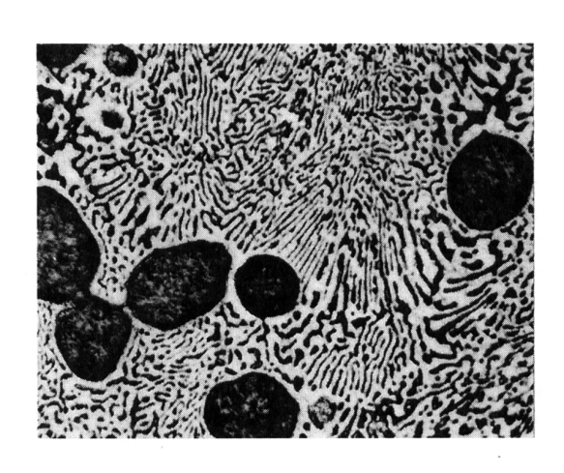

Hypoeutectic & Hypereutectic
300
L
T(°C)
α
L
+
α
200
L
+
β
β
(Pb-Sn
T_{E}
α
+
β
System)
100
0
20
40
60
80
100
C_{o}, wt% Sn
hypoeutectic: C_{o} = 50 wt% Sn
eutectic
hypereutectic: (illustration only)
61.9
α
eutectic: C_{o} = 61.9 wt% Sn
β
α
β
α
α
β
β
α
β
α
β
175 μm
160 μm
eutectic micro-constituent

Slide 17
Other Phase Diagrams
Peritectic
Eutectoid
Peritectoid

Slide 18
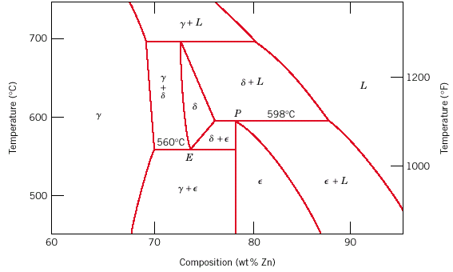
Eutectoid & Peritectic
Peritectic transition γ + L δ
Cu-Zn Phase diagram
Eutectoid transition δ γ + ε

